Slide 1
15, 17, 18. Inheritance, Polymorphism, and Interfaces
[ECE20016/ITP20003] Java Programming
Notes:
‹#›

Slide 2
Agenda
Inheritance Basics
Programming with Inheritance
Polymorphism
Interfaces and Abstract Classes

Slide 3
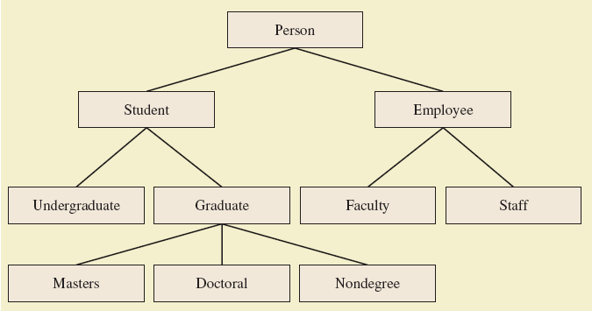
Class Hierarchy
A class hierarchy

Slide 4
Inheritance Basics
Inheritance allows programmer to define a general class.
Later you define a more specific class
Add new details to general definition
New class inherits all properties of initial, general class
class Person
https://github.com/lifove/InheritanceExample/blob/master/src/main/java/edu/handong/csee/java/example/inheritance/Person.java

Slide 5

Derived Classes
Class Person used as a base class
Also called superclass
Now we declare derived class Student
Also called subclass
Inherits methods from the superclass
class Student extends Person
https://github.com/lifove/InheritanceExample/blob/master/src/main/java/edu/handong/csee/java/example/inheritance/Student.java
class InheritanceDemonstrator
https://github.com/lifove/InheritanceExample/blob/master/src/main/java/edu/handong/csee/java/example/inheritance/InheritanceDemonstrator.java

Slide 6
Overriding Method Definitions
Note method writeOutput in class Student
Class Person also has method with that name
Method in subclass with same signature overrides method from base class
Overriding method is the one used for objects of the derived class
Overriding method must return same type of value

Slide 7
Overriding vs. Overloading
Overriding takes place in subclass – new method with same signature
Overloading
New method in same class with different signature

Slide 8
final Modifier for methods/classes
Possible to specify that a method cannot be overridden in subclass
Add modifier final to the heading
Ex) public final void specialMethod()
An entire class may be declared final
Thus cannot be used as a base class to derive any other class.

Slide 9
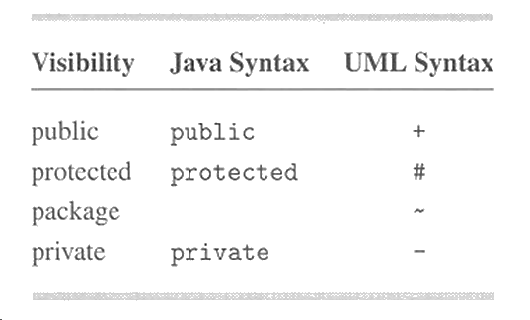
Private Instance Variables, Methods
Consider private instance variable in a base class
It is not inherited in subclass
It can be manipulated only by public accessor, modifier methods
Similarly, private methods in a superclass not inherited by subclass

Slide 10
Recall access modifiers for method
Scope \ Modifiers | public | protected | (default) | private
Same Class | O | O | O | O
Same Package | O | O | O
Sud(derived) Class | O | O
World | O

Slide 11
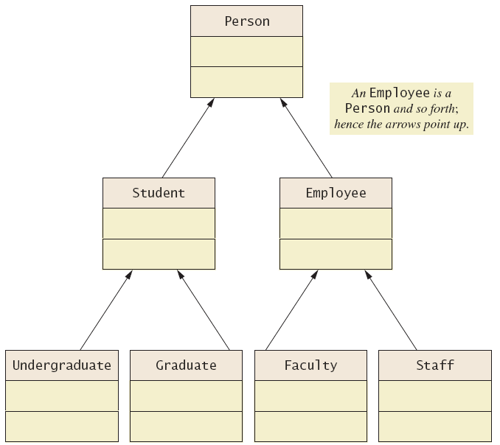
UML Inheritance Diagrams
A class hierarchy in UML notation

Slide 12
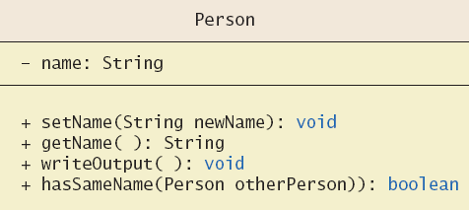
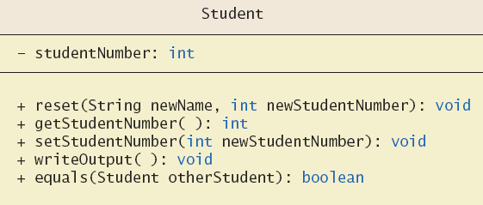
UML Inheritance Diagrams
Some details of UML class hierarchy

Slide 13
Agenda
Inheritance Basics
Programming with Inheritance
Polymorphism
Interfaces and Abstract Classes

Slide 14
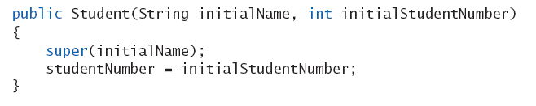
Constructors in Derived Classes
A derived class does not inherit constructors from base class
Constructor in a subclass must invoke constructor from base class
Use the reserved word super
Must be first action in the constructor

Slide 15

The this Method – Again
Also possible to use the this keyword
Use to call any constructor in the class
Calling constructor using method name is not allowed in Java.
Ex) Person(“No name yet”); // not valid.
Calling constructor from other methods is not allowed.
When used in a constructor, this calls constructor in same class.
Contrast use of super which invokes constructor of base class

Slide 16
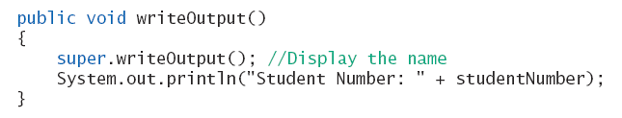
Calling an Overridden Method
Reserved word super can also be used to call method in overridden method
Calls method by same name in base class

Slide 17
Programming Example
A derived class of a derived class
class Undergraduate
https://github.com/lifove/InheritanceExample/blob/master/src/main/java/edu/handong/csee/java/example/inheritance/Undergraduate.java
Same as having all public members of both Person and Student classes even though Undergraduate does not have such pubic methods in it.
getName() in Person
getStudentNumber() in Student
This reuses the code in super classes

Slide 18
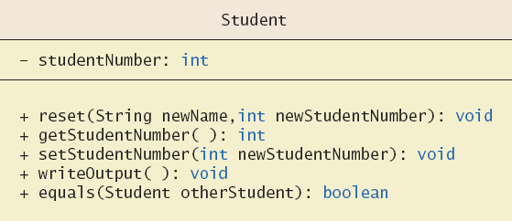
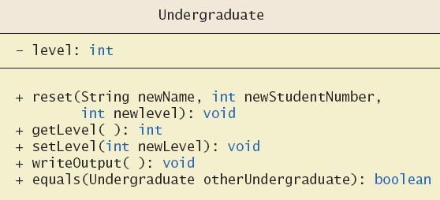
Programming Example
More details of the UML class hierarchy

Slide 19
Type Compatibility
In the class hierarchy
Each Undergraduate is also a Student
Each Student is also a Person
An object of a derived class can serve as an object of the base class.
Note this is not typecasting
An object of a class can be referenced by a variable of an ancestor type.

Slide 20
Type Compatibility
Be aware of the "is-a" relationship
Ex) A Student is a Person
Another relationship is the "has-a"
A class can contain (as an instance variable) an object of another type.
If we specify a date of birth variable for Person – it "has-a" Date object

Slide 21
The Class Object
Java has a class that is the ultimate ancestor of every class
The class Object
Thus possible to write a method with parameter of type Object
Actual parameter in the call can be an object of any type
Ex) println(Object theObject)

Slide 22
The Class Object
Class Object has some methods that every Java class inherits
Ex) equals, toString
Method toString called when println(theObject) invoked
Best to define your own toString to handle this.

Slide 23
A Better equals Method
The Student class has a equal method
public boolean equals (Student otherStudent) // overloaded equals method
{
return this.hasSameName (otherStudent) &&
(this.studentNumber == otherStudent.studentNumber);
}
Programmer of a class should override method equals from Object
public boolean equals (Object otherObject)
{
boolean isEqual = false;
if ((otherObject != null) && (otherObject instanceof Student)){
Student otherStudent = (Student) otherObject;
isEqual = this.sameName (otherStudent)
&& (this.studentNumber == otherStudent.studentNumber);
}
return isEqual;
}

Slide 24
Agenda
Inheritance Basics
Programming with Inheritance
Polymorphism
Interfaces and Abstract Classes

Slide 25
Polymorphism
Inheritance allows you to define a base class and derived classes from the base class
Polymorphism can let an object have many different forms. Subclasses of a class can define their own unique behaviors and yet share some of the same functionality of the parent class.

Slide 26
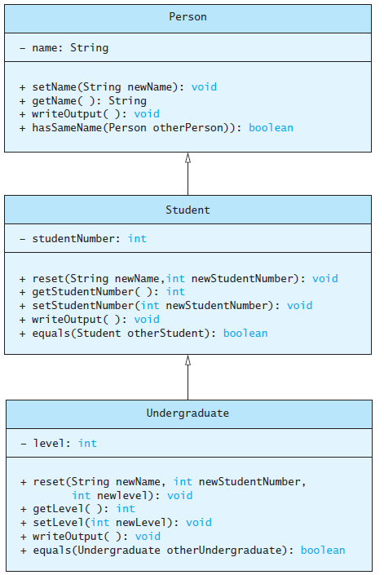
Polymorphism
Consider an array of Person
Person[] people = new Person[4];
Since Student and Undergraduate are types of Person, we can assign them to Person variables
people[0] = new Student(
"DeBanque, Robin", 8812);
people[1] = new Undergraduate(
"Cotty, Manny", 8812, 1);

Slide 27
Polymorphism Examples
Undergraduate ug = new Undergraduate("Nam, JC", 1111, 4);
Student st = ug;
Person ps = ug;
Object obj = ug;

Slide 28
Polymorphism
Given:
Person[] people = new Person[4];
people[0] = new Student("DeBanque, Robin", 8812);
When invoking:
people[0].writeOutput();
Which writeOutput() is invoked, the one defined for Student or the one defined for Person?
Answer: The one defined for Student

Slide 29
An Inheritance as a Type
The method can substitute one object for another.
Called polymorphism
e.g. call writeOutput() of a Person object (another) but writeOutput() of a sub class (one object) is actually called.
This is made possible by mechanism.
Dynamic binding
Also known as late binding

Slide 30
Dynamic Binding and Inheritance
When an overridden method invoked
Action matches method defined in class used to create object using new (i.e., actual instance!)
Not determined by type of variable naming the object
Variable of any ancestor class can have reference the object of descendant class
Object always remembers which method actions to use for each method name.
Ex) // Person is an ancestor of Undergraduate.
Person a = new Undergraduate();
a.writeOutput(); // Undergraduate.writeOutput();
a.setLevel(3); // error (Person does not have setLevel())

Slide 31
Polymorphism Example
public class PolymorphismDemonstrator
{
public static void main(String[] args) {
Person[] people = new Person[4];
people[0] = new Undergraduate("Cotty, Manny", 4910, 1);
people[1] = new Undergraduate("Kick, Anita", 9931, 2);
people[2] = new Student("DeBanque, Robin", 8812);
people[3] = new Undergraduate("Bugg, June", 9901, 4);
for (Person p : people) {
p.writeOutput();
System.out.println();
}
}
}

Slide 32
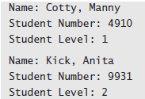
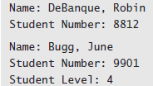
Polymorphism Example
Output

Slide 33
instanceof: Check a type of objects
public static void main(String[] args) {
Person[] people = new Person[4];
people[0] = new Undergraduate("Cotty, Manny", 4910, 1);
people[1] = new Undergraduate("Kick, Anita", 9931, 2);
people[2] = new Student("DeBanque, Robin", 8812);
people[3] = new Undergraduate("Bugg, June", 9901, 4);
for (Person p : people) {
System.out.println("Student Name: " + p.getName());
// we can call getLevel only in Undergraduate by casting p (Person).
// However, before cating we need to check if p is actually Undergraduate type by using 'instanceof'
if(p instanceof Undergraduate){
Undergraduate studentObj = (Undergraduate) p;
System.out.println("Student Level: " + studentObj.getLevel());
}
System.out.println();
}
}

Slide 34
Agenda
Inheritance Basics
Programming with Inheritance
Polymorphism
Interfaces and Abstract Classes

Slide 35
Class Interfaces
Consider a set of behaviors for pets
Be named
Eat
Respond to a command
We could specify method headings for these behaviors
These method headings can form a class interface

Slide 36
Class Interfaces
Without interfaces, we can still implement our own programs!
Then why do we need such method headings????? Interfaces are contracts that spell out how their software interacts
https://docs.oracle.com/javase/tutorial/java/IandI/createinterface.html

Slide 37
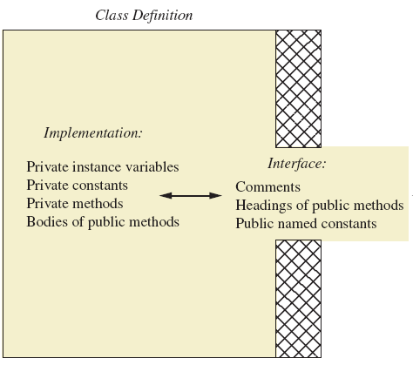
Class Definition vs. Interfaces
Programmer who uses the class

Slide 38
Class Interfaces
Now consider different classes that implement this interface.
They will have the same behaviors
Nature of the behaviors will be different
Each of the classes implements the behaviors/methods differently.

Slide 39
Java Interfaces
A program component that contains headings for a number of public methods
Will include comments that describe the methods
Interface can also define public named constants
Ex)
public interface Measurable
{
/** Returns the perimeter. */
public double getPerimeter ();
/** Returns the area. */
public double getArea ();
}

Slide 40
Java Interfaces
Interface name begins with uppercase letter
Stored in a file with suffix .java
Interface does not include
Declarations of constructors
Instance variables
Method bodies

Slide 41
Implementing an Interface
To implement a method, a class must
Include the phrase implements Interface_name
Define each specified method
class Rectangle implements Measurable
class Circle implements Measurable
https://github.com/lifove/InterfaceExample/tree/master/src/main/java/edu/handong/csee/java/example

Slide 42
Interface as a Type
You can declare a variable of an Interface type.
Ex) // Rectangle implements Measurable
Measurable a = new Rectangle(100, 200);
System.out.println("a.getArea() = " + a.getArea());
You cannot create an object of an Interface type using the new operator.
An Interface cannot have a Constructor.
Ex) Measurable a = new Measurable (); // error

Slide 43
Interface as a Type
Possible to write a method that has a parameter as an interface type
An interface is a reference type
public void myMethod(Measurable measure) { … }
An object of any class which implements that interface can be an argument for the method.
Measurable myMeasurable = new Rectangle(100,200); myMethod(myMeasurable);

Slide 44
Extending an Interface
Possible to define a new interface which builds on an existing interface
It is said to extend the existing interface
public interface MeasurableForVolume extends Measurable { public double getVolume(); }
A class that implements the new interface must implement all the methods of both interfaces
e.g. ,getPerimeter(), getArea(), getVolume()

Slide 45
Implement a built-in interface
Java has many predefined interfaces
One of them, the Comparable interface, is used to impose an ordering upon the objects that implement it
A class implementing Comparable can be sorted by Arrays.sort() method.
Requires that the method compareTo be written
public int compareTo(Object other);

Slide 46
Comparable example
Apply Arrays.sort(...) for Salesman
https://github.com/lifove/SalesReporter/tree/master/src/main/java/edu/handong/csee/java/example

Slide 47
Case Study
Character Graphics
interface ShapeInterface
If we wish to create classes that draw rectangles and triangles
We could create interfaces that extend ShapeInterface

Slide 48
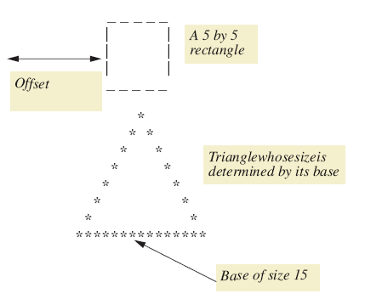
Case Study
A sample rectangle and triangle

Slide 49
Base Interface ShapeInterface
public interface ShapeInterface
{
/**
Sets the offset for the shape.
*/
public void setOffset (int newOffset);
/**
Returns the offset for the shape.
*/
public int getOffset ();
/**
Draws the shape at lineNumber lines down
from the current line.
*/
public void drawAt (int lineNumber);
/**
Draws the shape at the current line.
*/
public void drawHere ();
}

Slide 50
Derived Interfaces
/**
Interface for a rectangle to be drawn on the screen.
*/
public interface RectangleInterface extends ShapeInterface
{
/**
Sets the rectangle's dimensions.
*/
public void set (int newHeight, int newWidth);
}
/**
Interface for a triangle to be drawn on the screen.
*/
public interface TriangleInterface extends ShapeInterface
{
/**
Sets the triangle's base.
*/
public void set (int newBase);
}

Slide 51
Case Study
A base class which uses (implements) previous interfaces class ShapeBasics
Note
Method drawAt calls drawHere
Derived classes must override drawHere
Modifier extends comes before implements

Slide 52
Case Study
Note algorithm used by method drawHere to draw a rectangle
Draw the top line
Draw the side lines
Draw the bottom lines
Subtasks of drawHere are realized as private methods
class Rectangle

Slide 53
Case Study
class Triangle
It is a good practice to test the classes as we go
class TreeDemonstrator
https://github.com/lifove/InterfaceExample/tree/master/src/main/java/edu/handong/csee/java/example/keyboard/characters

Slide 54
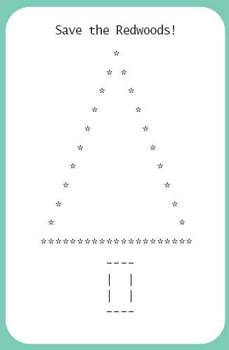
Case Study

Slide 55
Sorting an Array of Fruit Objects
Initial (non-working) attempt to sort an array of Fruit objects
class Fruit and class FruitDemontrator
https://github.com/lifove/InterfaceExample/tree/master/src/main/java/edu/handong/csee/java/example/comparable/without
Result: Exception in thread “main”
Sort tries to invoke compareTo method but it doesn’t exist

Slide 56
Sorting an Array of Fruit Objects
Working attempt to sort an array of Fruit objects – implement Comparable, write compareTo method
class Fruit
https://github.com/lifove/InterfaceExample/blob/master/src/main/java/edu/handong/csee/java/example/comparable/Fruit.java

Slide 57
compareTo Method
An alternate definition that will sort by length of the fruit name
public int compareTo(Fruit otherFruit) {
if(fruitName.length() > otherFruit.fruitName.length())
return 1;
else if (fruitName.length() < otherFruit.fruitName.length())
return -1;
else
return 0;
}

Slide 58
Agenda
Inheritance Basics
Programming with Inheritance
Polymorphism
Interfaces and Abstract Classes

Slide 59
Abstract Classes
We can add method headings without implementation of its body in a super class by defining it as an abstract class.
Class ShapeBasics is designed to be a base class for other classes
Method drawHere will be redefined for each subclass
It should be declared abstract – a method that has no body
This makes the class abstract
You cannot create an object of an abstract class – thus its role as base class.

Slide 60
Abstract Classes
Not all methods of an abstract class are abstract methods
Abstract class makes it easier to define a base class
Specifies the obligation of designer to override the abstract methods for each subclass
Cannot have an instance of an abstract class
But OK to have a parameter of that type

Slide 61
Abstract Classes
https://github.com/lifove/InterfaceExample/blob/master/src/main/java/edu/handong/csee/java/example/keyboard/characters/ShapeBase.java
public abstract class ShapeBase implements ShapeInterface
{
private int offset;
public abstract void drawHere ();
/*
The rest of the class is identical to ShapeBasics, except for the
names of the constructors. Only the method drawHere is abstract.
Methods other than drawHere have bodies and do not have the keyword
abstract in their headings.
We repeat one such method here:
*/
public void drawAt (int lineNumber)
{
for (int count = 0 ; count < lineNumber ; count++)
System.out.println ();
drawHere ();
}
}

Slide 62
Dynamic Binding and Inheritance
Note how drawAt(in ShapeBasics) makes a call to drawHere
Class Rectangle overrides method drawHere
How does drawAt know where to find the correct drawHere?
Happens with dynamic or late binding
Address of correct code to be executed determined at run time

